Slide 1
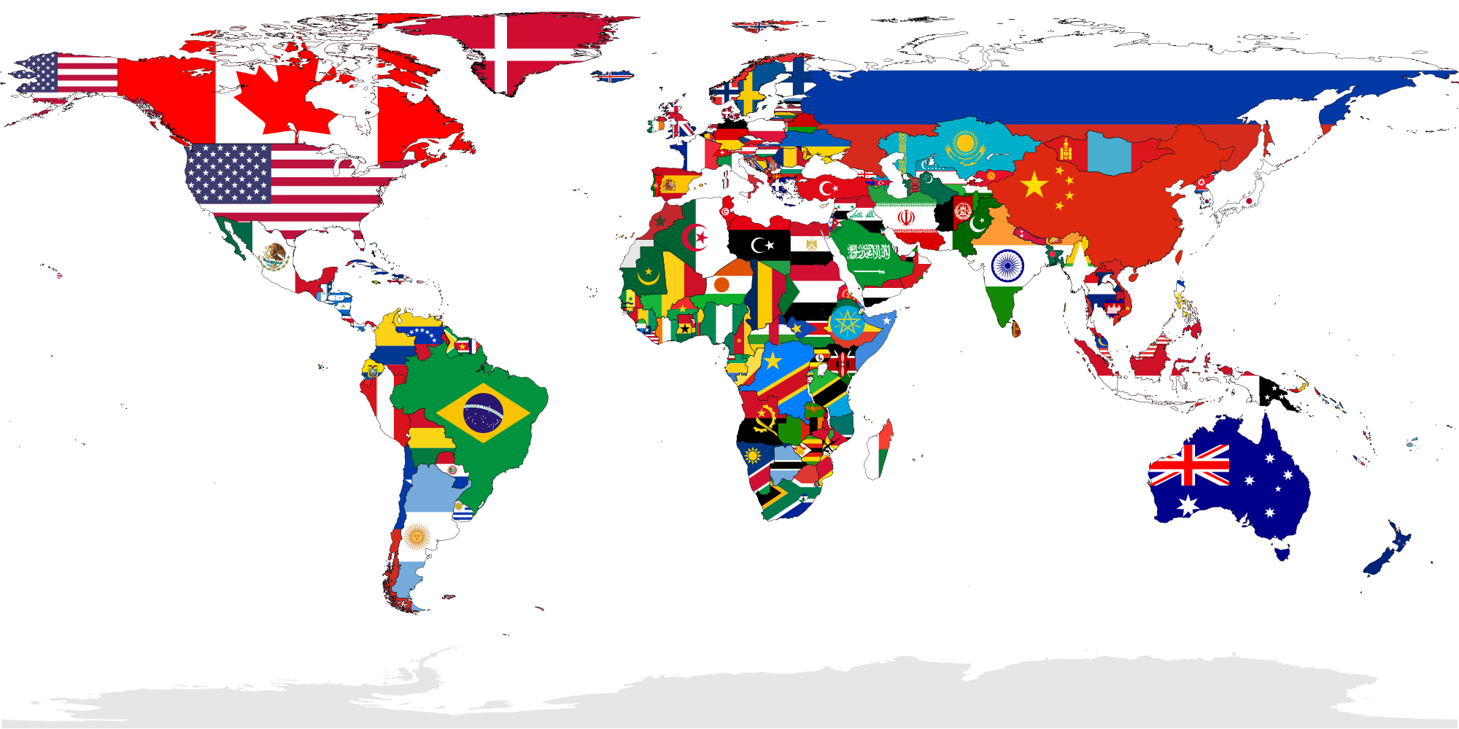
Micro Money for People & Big Data for Business Prepared by Micromoney team
15.05.2017

Slide 2
Our Journey Started in Asia Mission: To Bring 2.500.000.000 unbanked & un(der)served people to the New World Global Decentralized Crypto Economy
-Enable worldwide banks, financial companies, e-commerce & retail businesses to efficiently scale community investments and service more (before nowadays fully untouched) customers -Enable blockchain companies to efficiently scale customer base by getting access to open source decentralized credit bureau with millions of un(der)served people

Slide 3

Table Of Contents
1 | China | 3
2 | Myanmar | 11
3 | Indonesia | 20
4 | Sri-Lanka | 31
5 | Malaysia | 41
6 | Hong Kong | 50
7 | Thailand | 56
8 | Singapore | 67
9 | Philippines | 75
10 | Cambodia | 84
11 | Vietnam | 91
11 | Annexes | 93

